Slide 1

Framework for extracting and solving combination puzzles
Vitalii Zakharov
Supervisor: Artjom Lind, MSc
Notes:
Good morning ladies and gentlemen, respectable members of the committee.

Slide 2
Objectives
Thesis questions to answer for the given problem:
How computer vision can be applied?
How Simultaneous localization and mapping (SLAM) & Tracking and Mapping algorithms can be applied?
How to render a combination puzzle object?
How to map data from the digital sources to the virtual model?
How to solve the combination puzzle?
Notes:
Talk about why I decided to do this project. For instance, to help people with solving puzzles with the help of computer without stupid showing each piece of face inside special area.

Slide 3
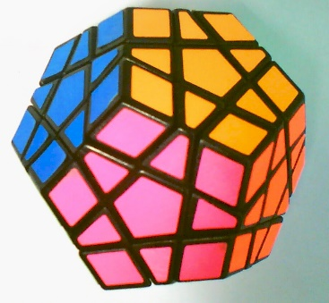
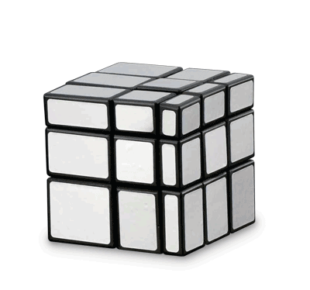
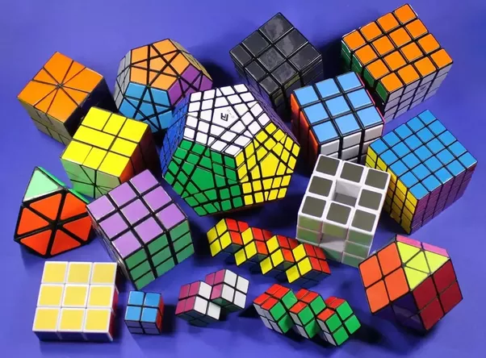
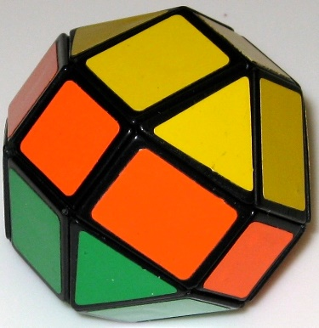
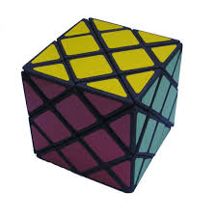
Combination puzzles

Slide 4
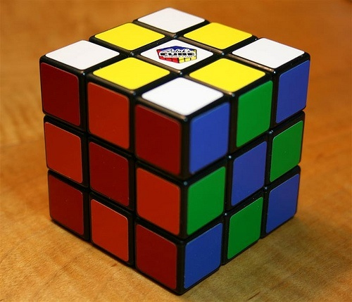
Rubik’s cube

Slide 5
Workflow distinct stages
Detection (detect the cube’s face within the image)
Extraction (extract the face from the corresponding image)
Mapping (map color data to the Rubik’s cube virtual model)
Solving (solve the Rubik’s cube virtual model)
Rendering (render the Rubik’s cube virtual model)
Notes:
Talk about distinction of stages. Separate libraries and their substitution.

Slide 6
Detection and Extraction
Examined approaches for the cube’s face detection:
Contours based approach
Parallel Tracking and Mapping (PTAM) based planes intersection approach
PTAM and contours (mix) based approach
To handle different combination puzzles detection and extraction there should be created the new libraries.
Notes:
Say how many approaches were studied and mention their name with brief descripton.

Slide 7
Contours based face detection
Main ideas:
Detect and filter all contours in the image.
Distinct contours by their angle between contour diagonal and horizon.
Find extremum points (face’s corners) within the set of contour’s points.
Apply perspective transformation to extract the face from the image using the found points.
Notes:
Describe how contours are filtered (contour area threshold, contour is convex and it’s approximation gives 4 points, center of mass). Angle filtering is needed to discard contours from different faces because they should be under different angle when seen at the same view.

Slide 8
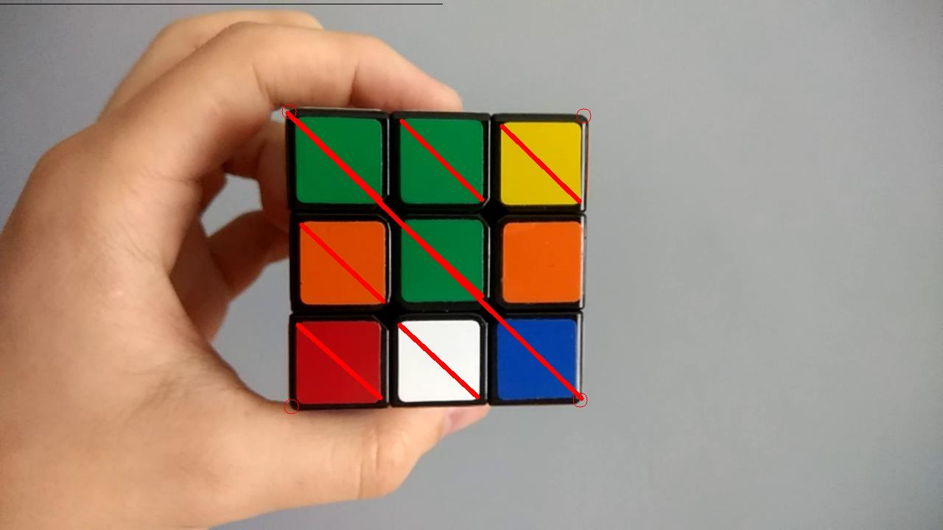
Contours based face detection example

Slide 9
SLAM & Tracking and Mapping
There are multiple algorithms within these groups:
Simultaneous localization and mapping (SLAM)
Parallel Tracking and Mapping for Small AR Workspaces (PTAM)
Dense Tracking and Mapping in Real-Time (DTAM)
Notes:
SLAM – navigation thus camera position tracking, PTAM & DTAM augmented reality plane information analysis

Slide 10
PTAM based face detection
Requires bootstrapping (smooth movements)
Allows to track plane after bootstrapping
Allows to get plane’s data
Assumes that the plane is a cube’s face
Uses contours to find the boundaries of the face within the plane
Notes:
Talk about approach, describe it’s abilities.

Slide 11
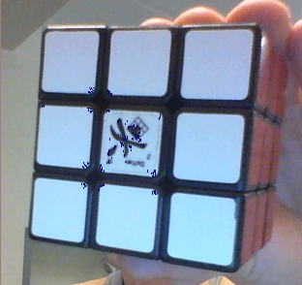
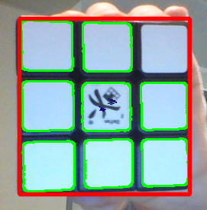
PTAM based face detection example

Slide 12
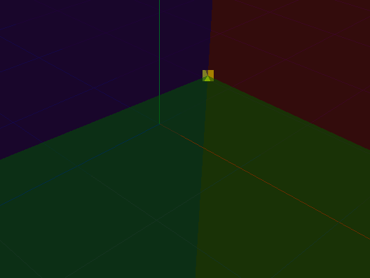
PTAM based planes intersection approach
Ideas behind the approach:
Bootstrap all planes in a row
Analyze every 3 contiguous planes
Extract 3D coordinates of the planes intersection points within created relative 3D space.
Use extracted points to extract faces when they are seen in the view
Use extracted points to track cube’s orientation

Slide 13
PTAM tracking
Tracking is the purpose of PTAM.
Possible usage:
Use PTAM to compute camera orientation
Use PTAM to compute combination puzzle orientation
Track object’s rotation and translation with received data within the observed view
Notes:
Talk about PTAM’s tracking nature and though it could be used for tracking the cube.

Slide 14
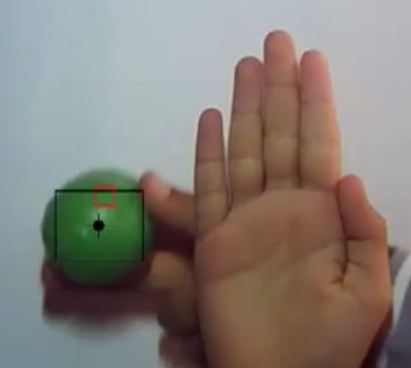
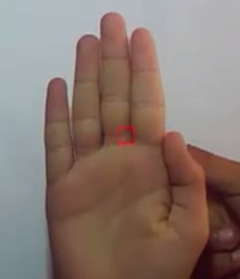
Kalman filter
Explored possible improvements:
Allows to track cube’s uniform and continuous rotations with only one face used
Allows to track any cube’s rotations and translations with all cube’s corners known. Achieved by Kalman filter updating stage

Slide 15
Mapping
Mapping is a stage where all unique and extracted faces images are mapped to the corresponding places in the virtual model.
Achieved by:
Segmenting images into distinct pieces
Taking color probes from these pieces
Analyzing virtual faces with mapped colors for conformity check
Notes:
Describe what is mapping and how it is done.

Slide 16
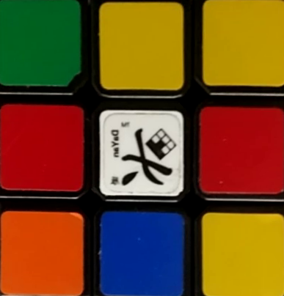
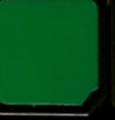
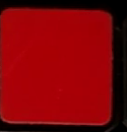
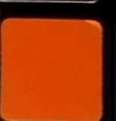
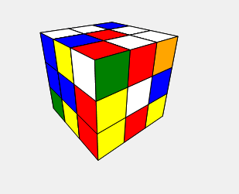

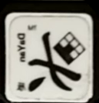
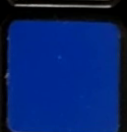
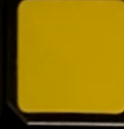
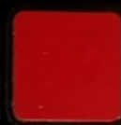
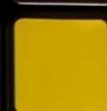
Mapping demonstration

Slide 17
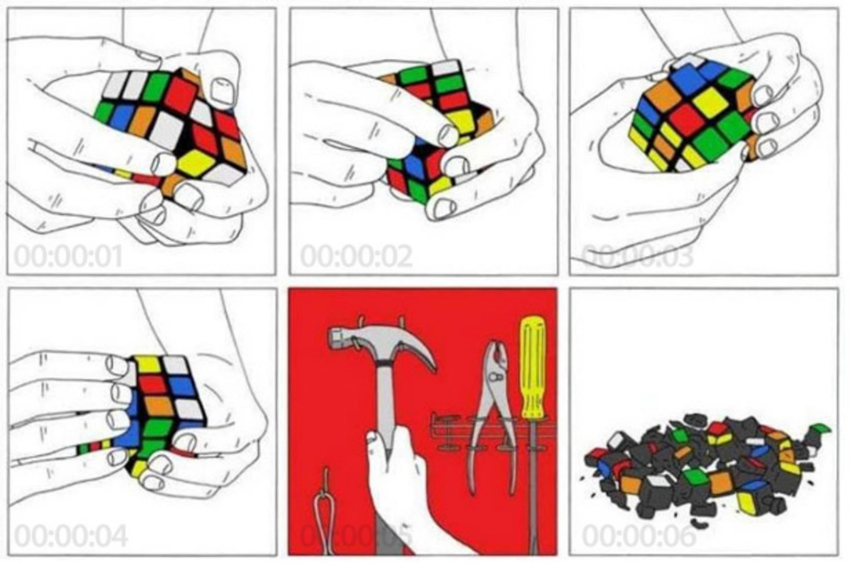
Solving methods
Beginners method (~ 10 formulas)
Fridrich method (> 100 formulas)
Method of Valeriy Morozov (intuitive)
Notes:
Say why beginners method has been chosen.

Slide 18
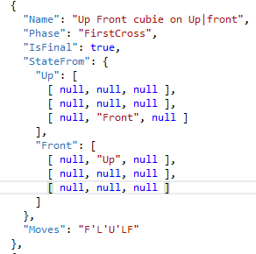
Solving methodology
Describe majority of states with formulas to process with fancy JSON notation
Implement solution stages order and flips/rotations of a cube in the solution adapter
Solve the cube and be happy

Slide 19
Software Rendering
Simple software rendering engine was developed.
Abilities:
Render primitive objects as Meshes (set of polygons)
Polygons are simply projected to the screen using screen size, field of view angle, scale and view distance parameters
Allows to rotate the mesh on the screen
Allows to scale the image

Slide 20
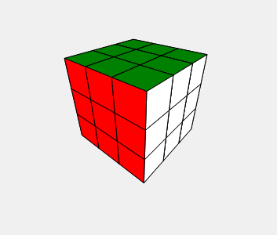
Rendering demonstration

Slide 21
Conclusion
Achieved goals:
Extract a puzzle color data ✓
Solve the puzzle using extracted color data ✓
Render the puzzle using extracted color data ✓
Help people with combination puzzles solving in interactive and entertaining way ✓

Slide 22
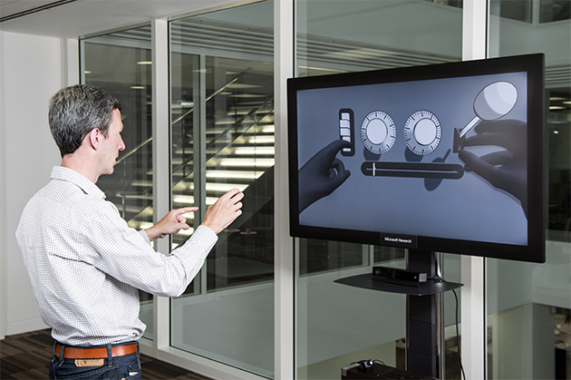
Future perspectives
Apply PTAM to track cube’s movements
Apply Kalman filter to improve cube’s tracking
Use tracking feature to improve interactivity, for instance, rotate virtual model using the real cube in front of camera

Slide 23

Video demonstration

Slide 24
Thank you for attention!
Questions?

